Slide 1
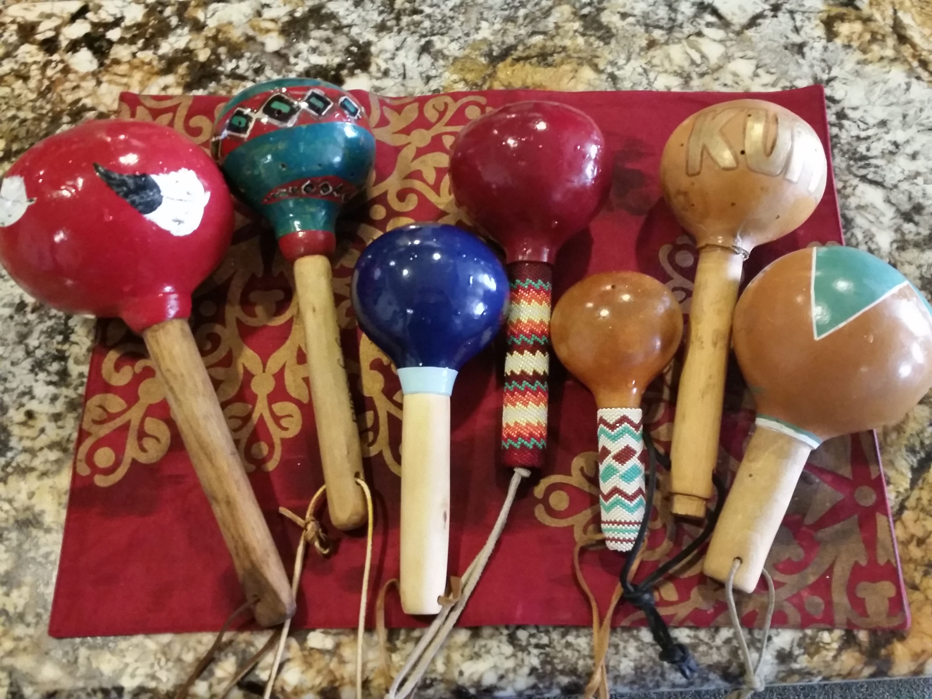
Addressing American Indian Health Disparities
Claradina Soto, PhD, MPH
Department of Preventive Medicine,
Keck School of Medicine of USC
University of Southern California

Slide 2
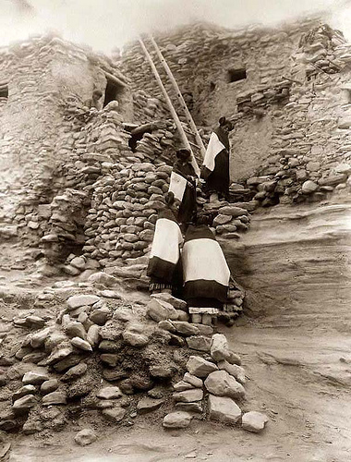
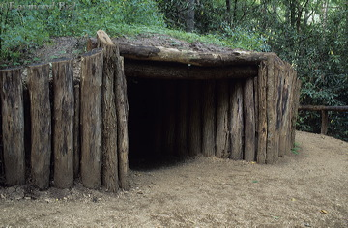
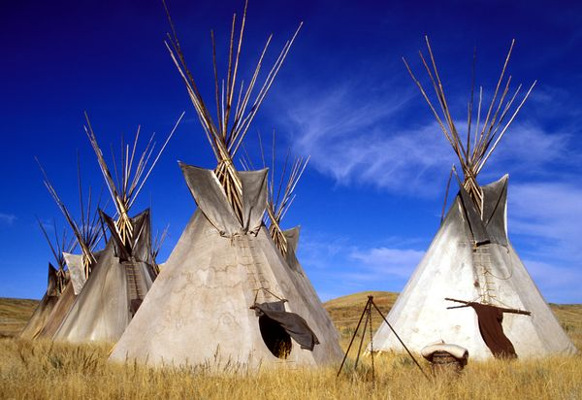
American Indian and Alaska Native Populations
In the United States, 5.2 million people identify as American Indian (AI) or Alaska Native (AN)
560+ different AI/AN tribes in the US
Alaska
229 federally recognized tribes
Navajo Nation Tribe
Largest Indian Reservation
Over 200 indigenous languages

Slide 3
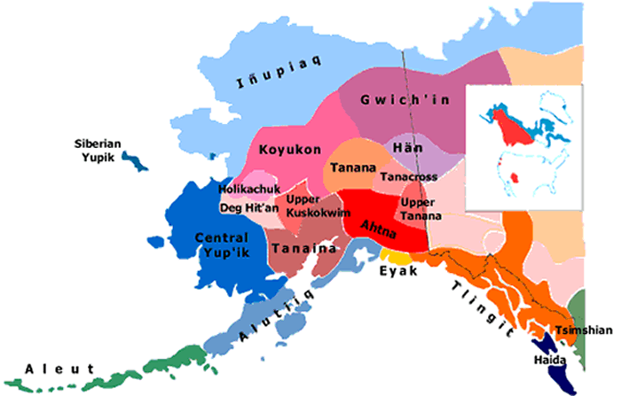
Alaska Natives
Notes:
This provides a visual of the Alaskan Tribal groups that exist in the state.
Northwest Coast Indians
Inupiaqs
Yupiks
Aleuts
Athabascans

Slide 4
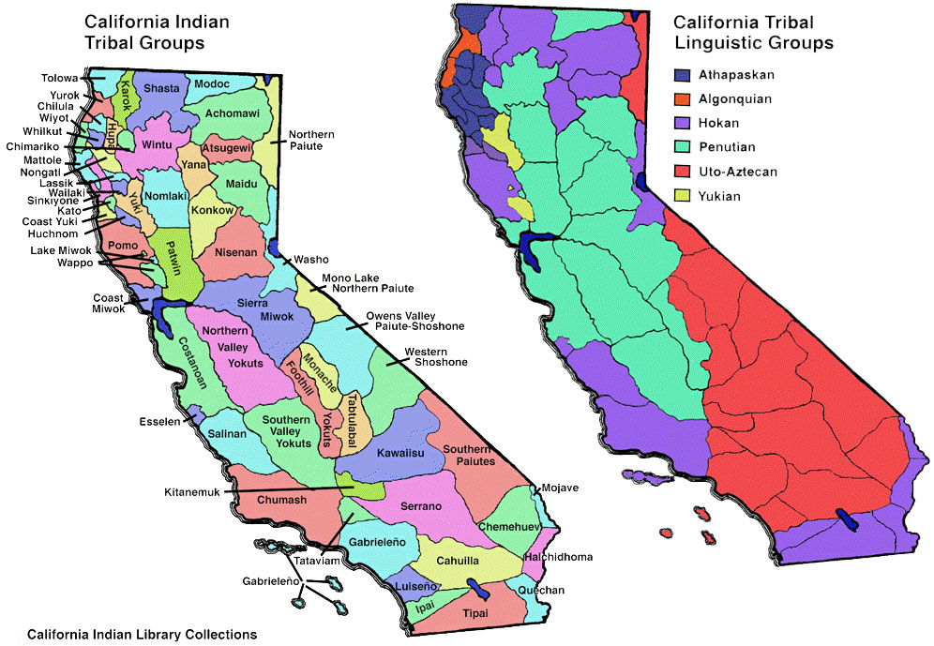
AIAN Population in California-Urban and Tribal
California has the largest AIAN population in the US -over 720,000 AIAN individuals
~2% of the CA population
There are 109 Federally recognized tribes in California.
AIANs in California--including California Indians and AIANs who relocated from other states--are dispersed throughout rural and urban areas around the state.
This was primarily due to the US government policies that relocated AIANs from reservations to urban areas.

Slide 5
Working with Community
Tribal Sovereignty
Each tribe has the inherent right to govern their tribal members and tribal lands.
Laws of the state do not necessarily apply to AI governments.
Federal government works with tribes on a government-to-government basis.
Elected tribal leaders (e.g., Chairman, Governor, President).
Researchers must secure approval by tribal governments (e.g., Tribal IRB).

Slide 6
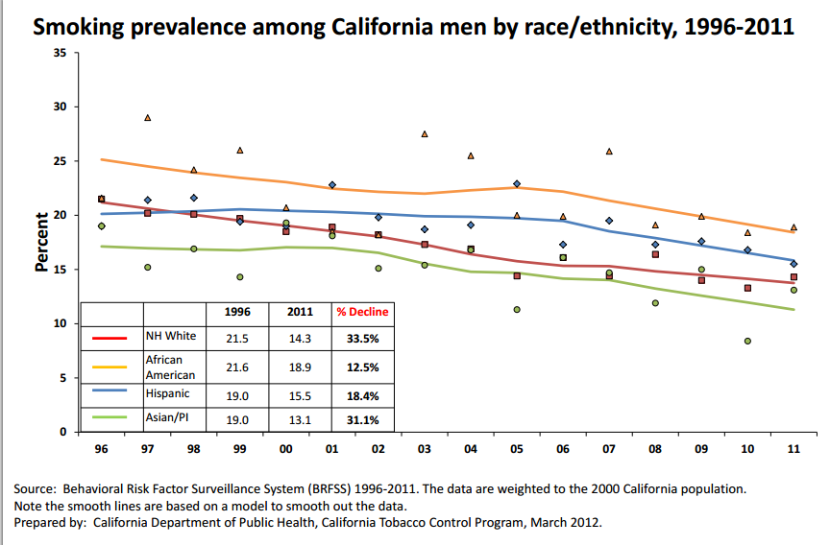
CA Smoking Prevalence
Add graph

Slide 7
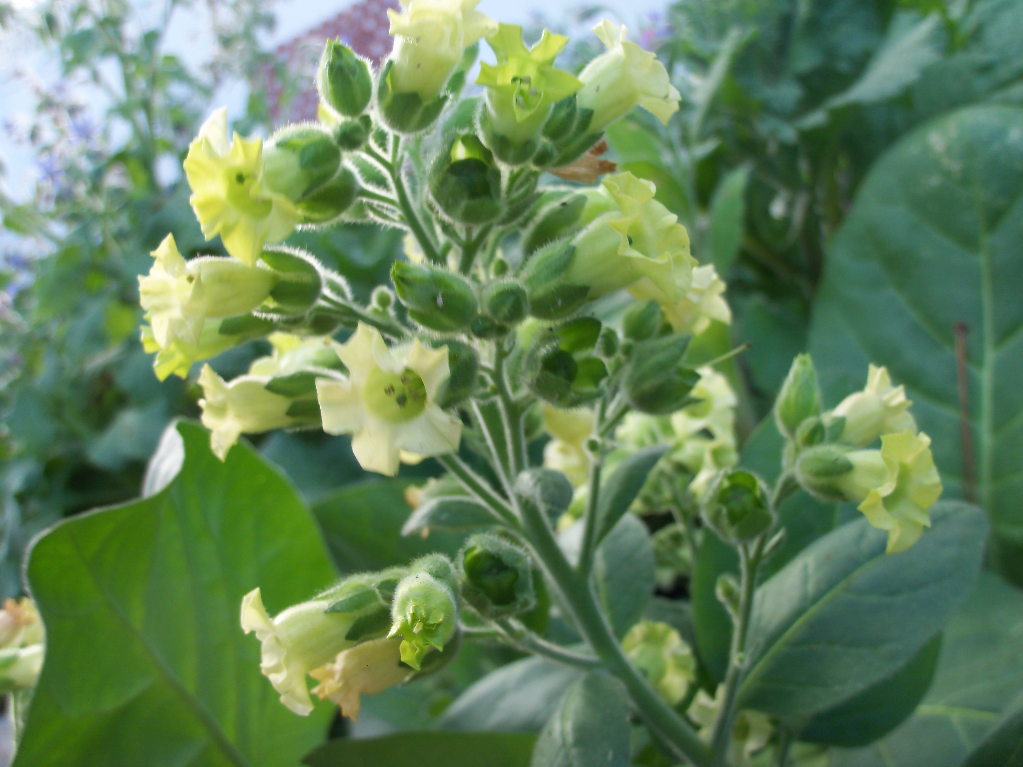
Research Projects Working with Tribal Communities

Slide 8

Tobacco Survey Among AI Youth
Developed culturally specific survey instrument with input from AI advisory committee (AC) members. Pilot tested (n=96) and revised survey.
Sample of 1,076 AI adolescents (urban and rural) who completed surveys.
Survey topics included:
Cigarette Use
Ceremonial & Non-ceremonial tobacco use
Quitting smoking
American Indian activities (pow-wows, sweat lodge, etc.);
Incentives:
Students received a $6 value gift for completion of a survey
Organizations received monetary gift for participating

Slide 9
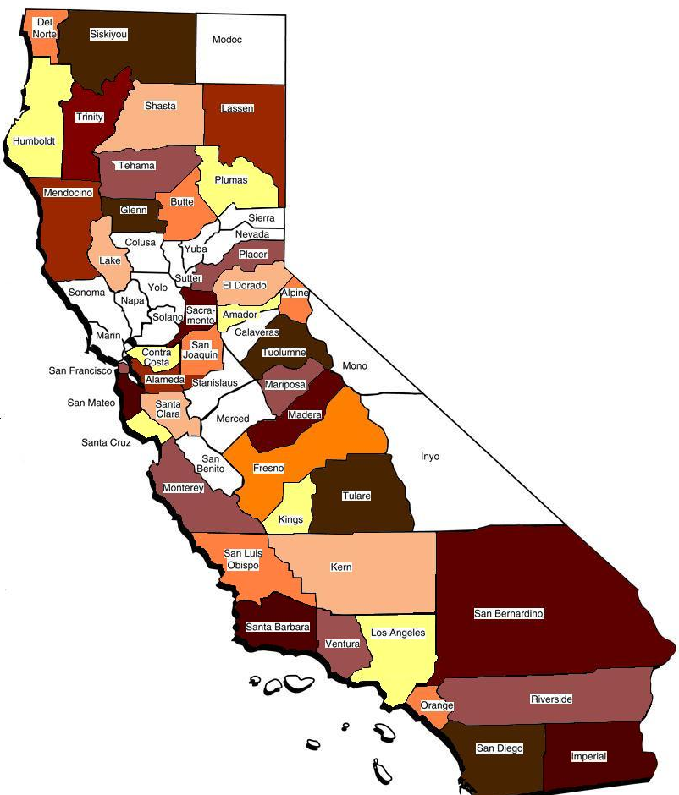
Tobacco Survey Among AI Youth
Of the 58 counties in California, this map reflects the 41 counties in which survey participants reside, according to the zip codes they provided on the survey.
N=49 Sites (schools, youth groups, cultural gatherings)

Slide 10
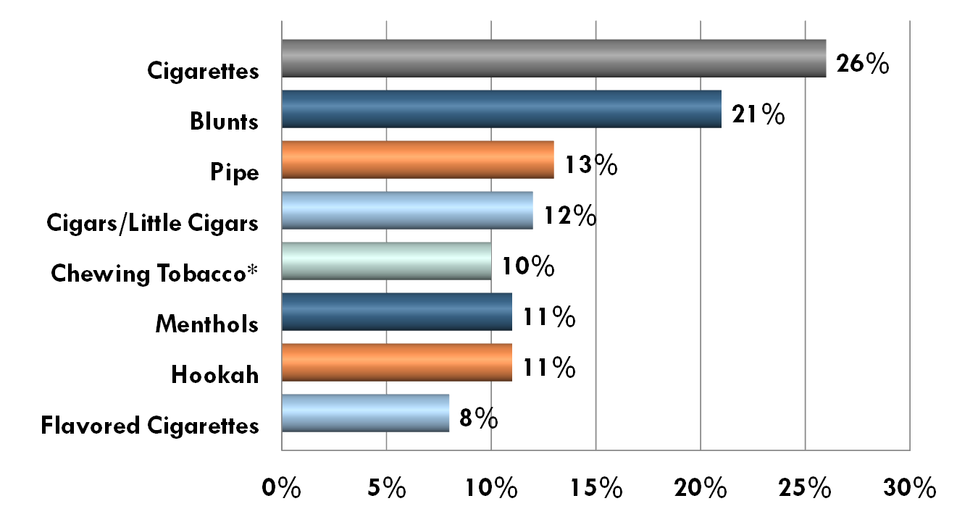
Other Tobacco Products Used in Last 30 Days

Slide 11
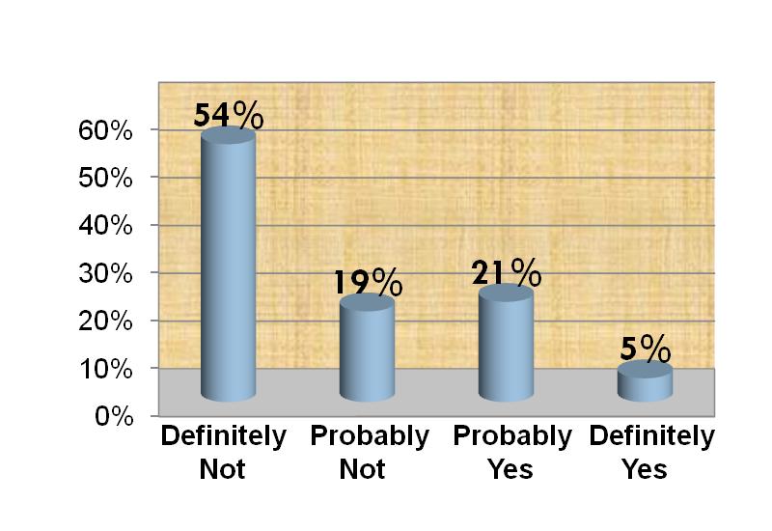
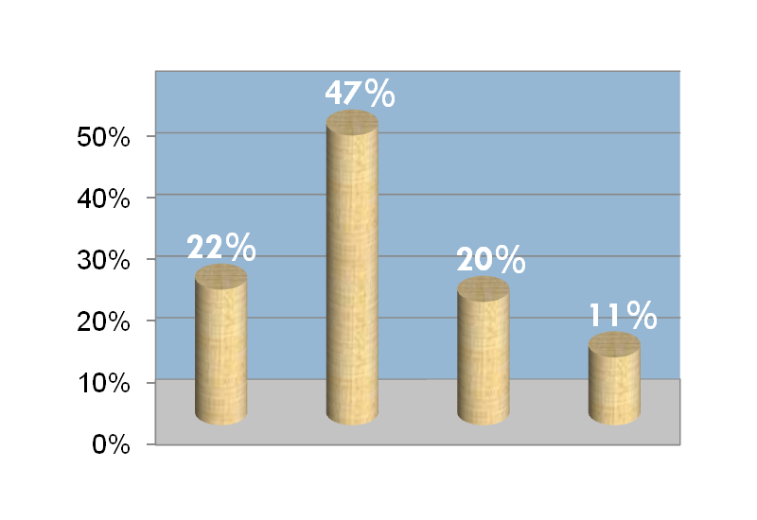
Cigarette Use
Age at First Puff
Will Smoke in Next Year
7-9 10-13 14-15 16-older

Slide 12
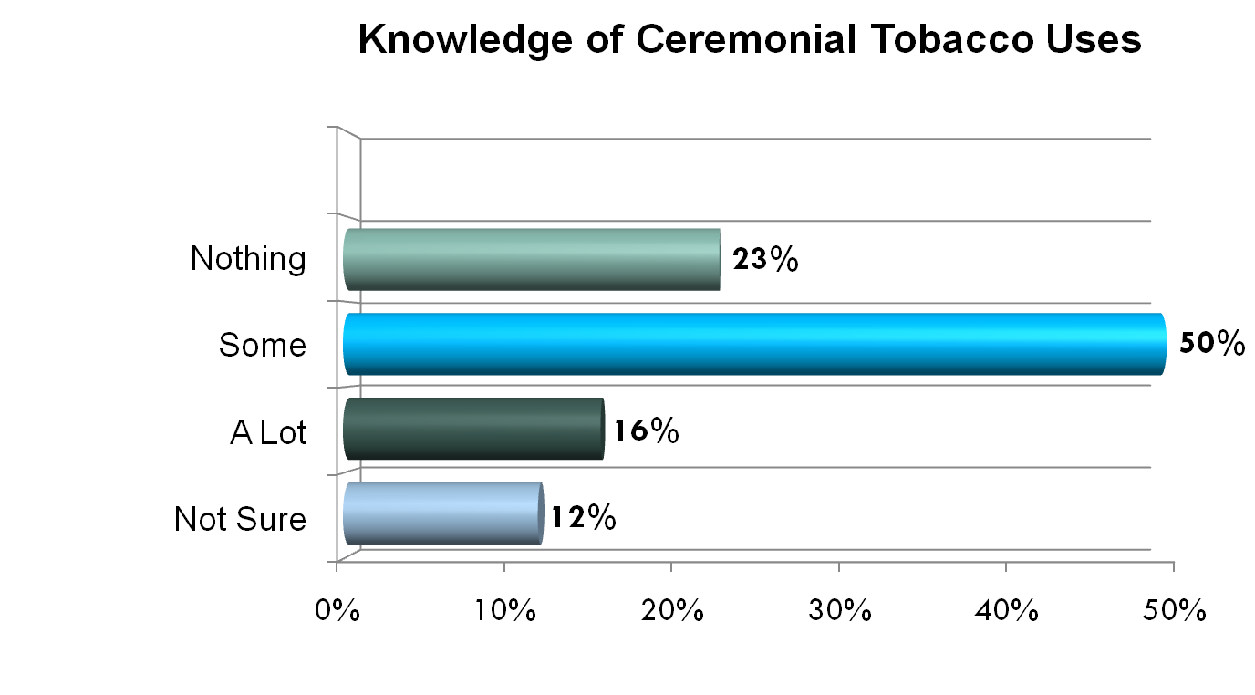
Traditional Uses of Tobacco

Slide 13
Health Promotion
Traditional Tobacco
Health Promotion Message Examples

Slide 14
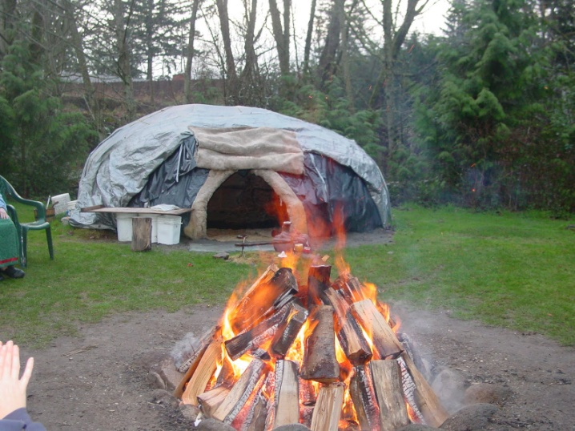
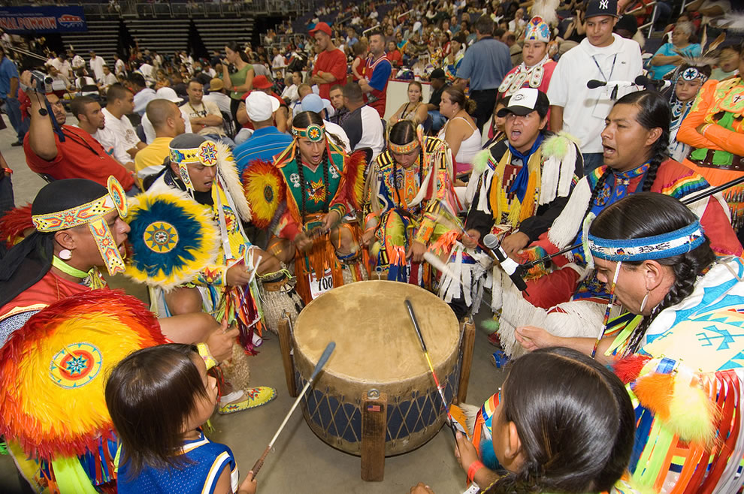
Tobacco as a Sacred Offering
Ceremonial Use of Tobacco
Sweat Lodges
Drum Groups
Offering of Prayers
Tobacco as a spiritual gift

Slide 15
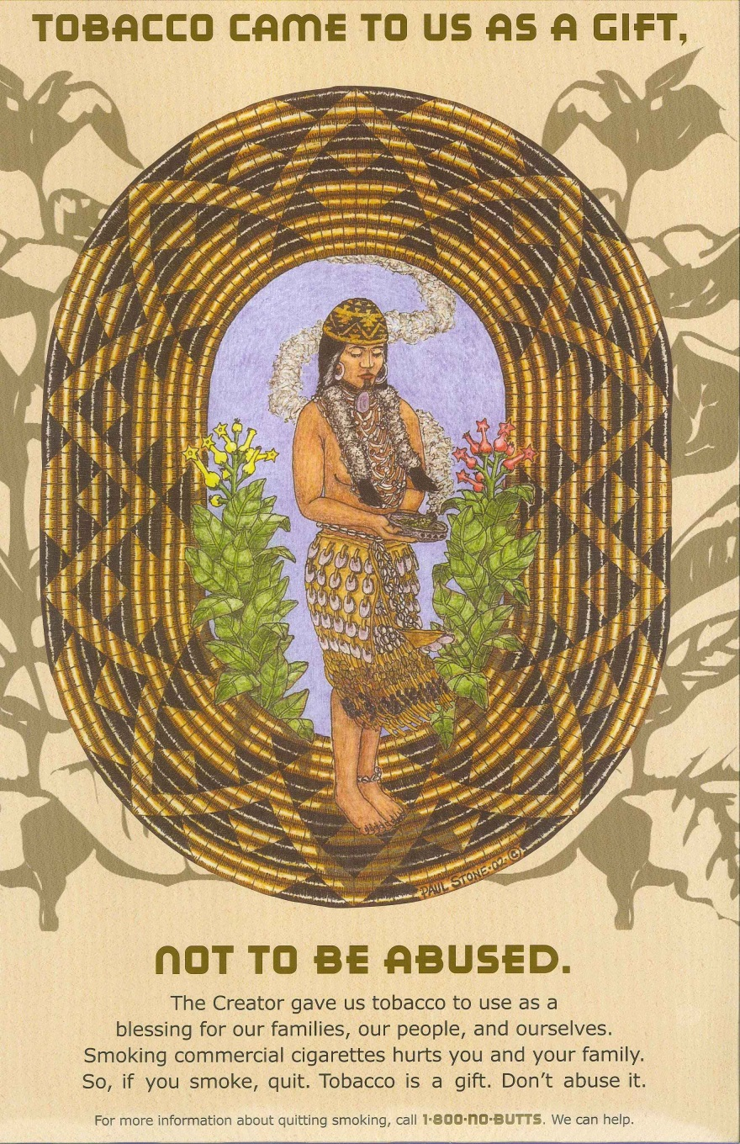
Traditional Tobacco Message

Slide 16
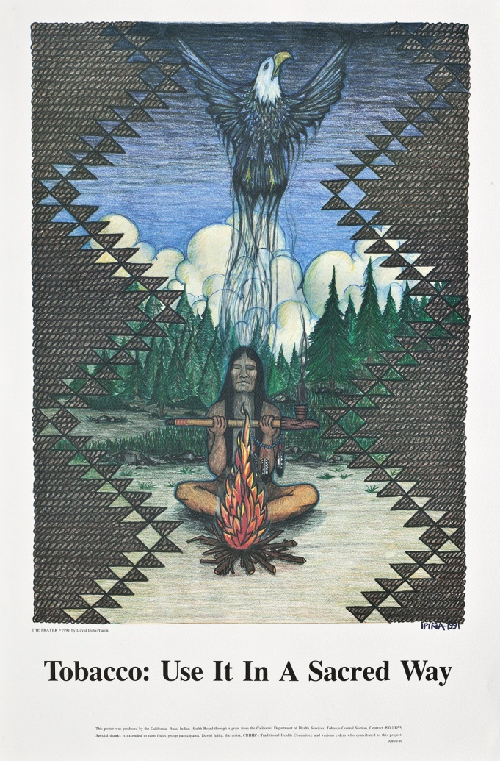
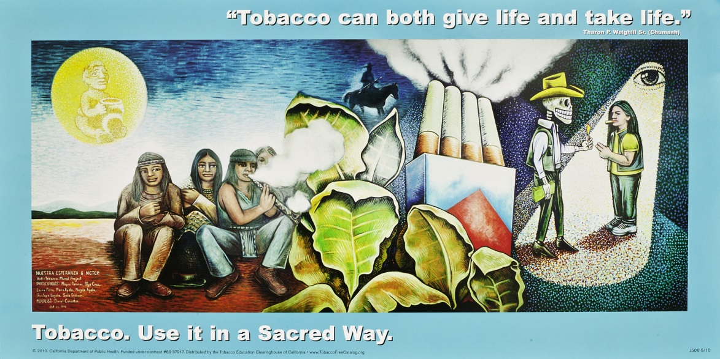
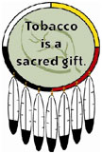
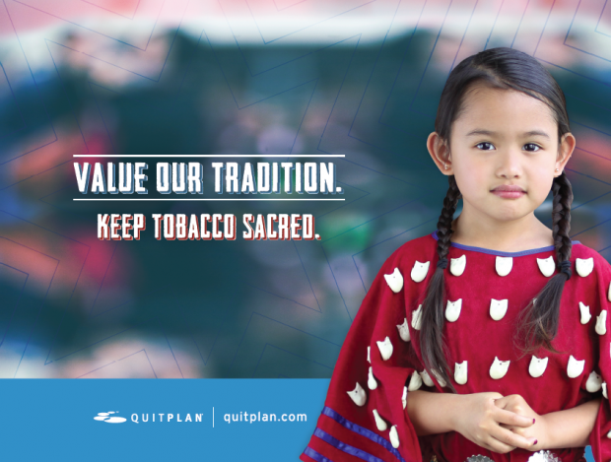

Slide 17
Interventions for native teens
Research projects

Slide 18
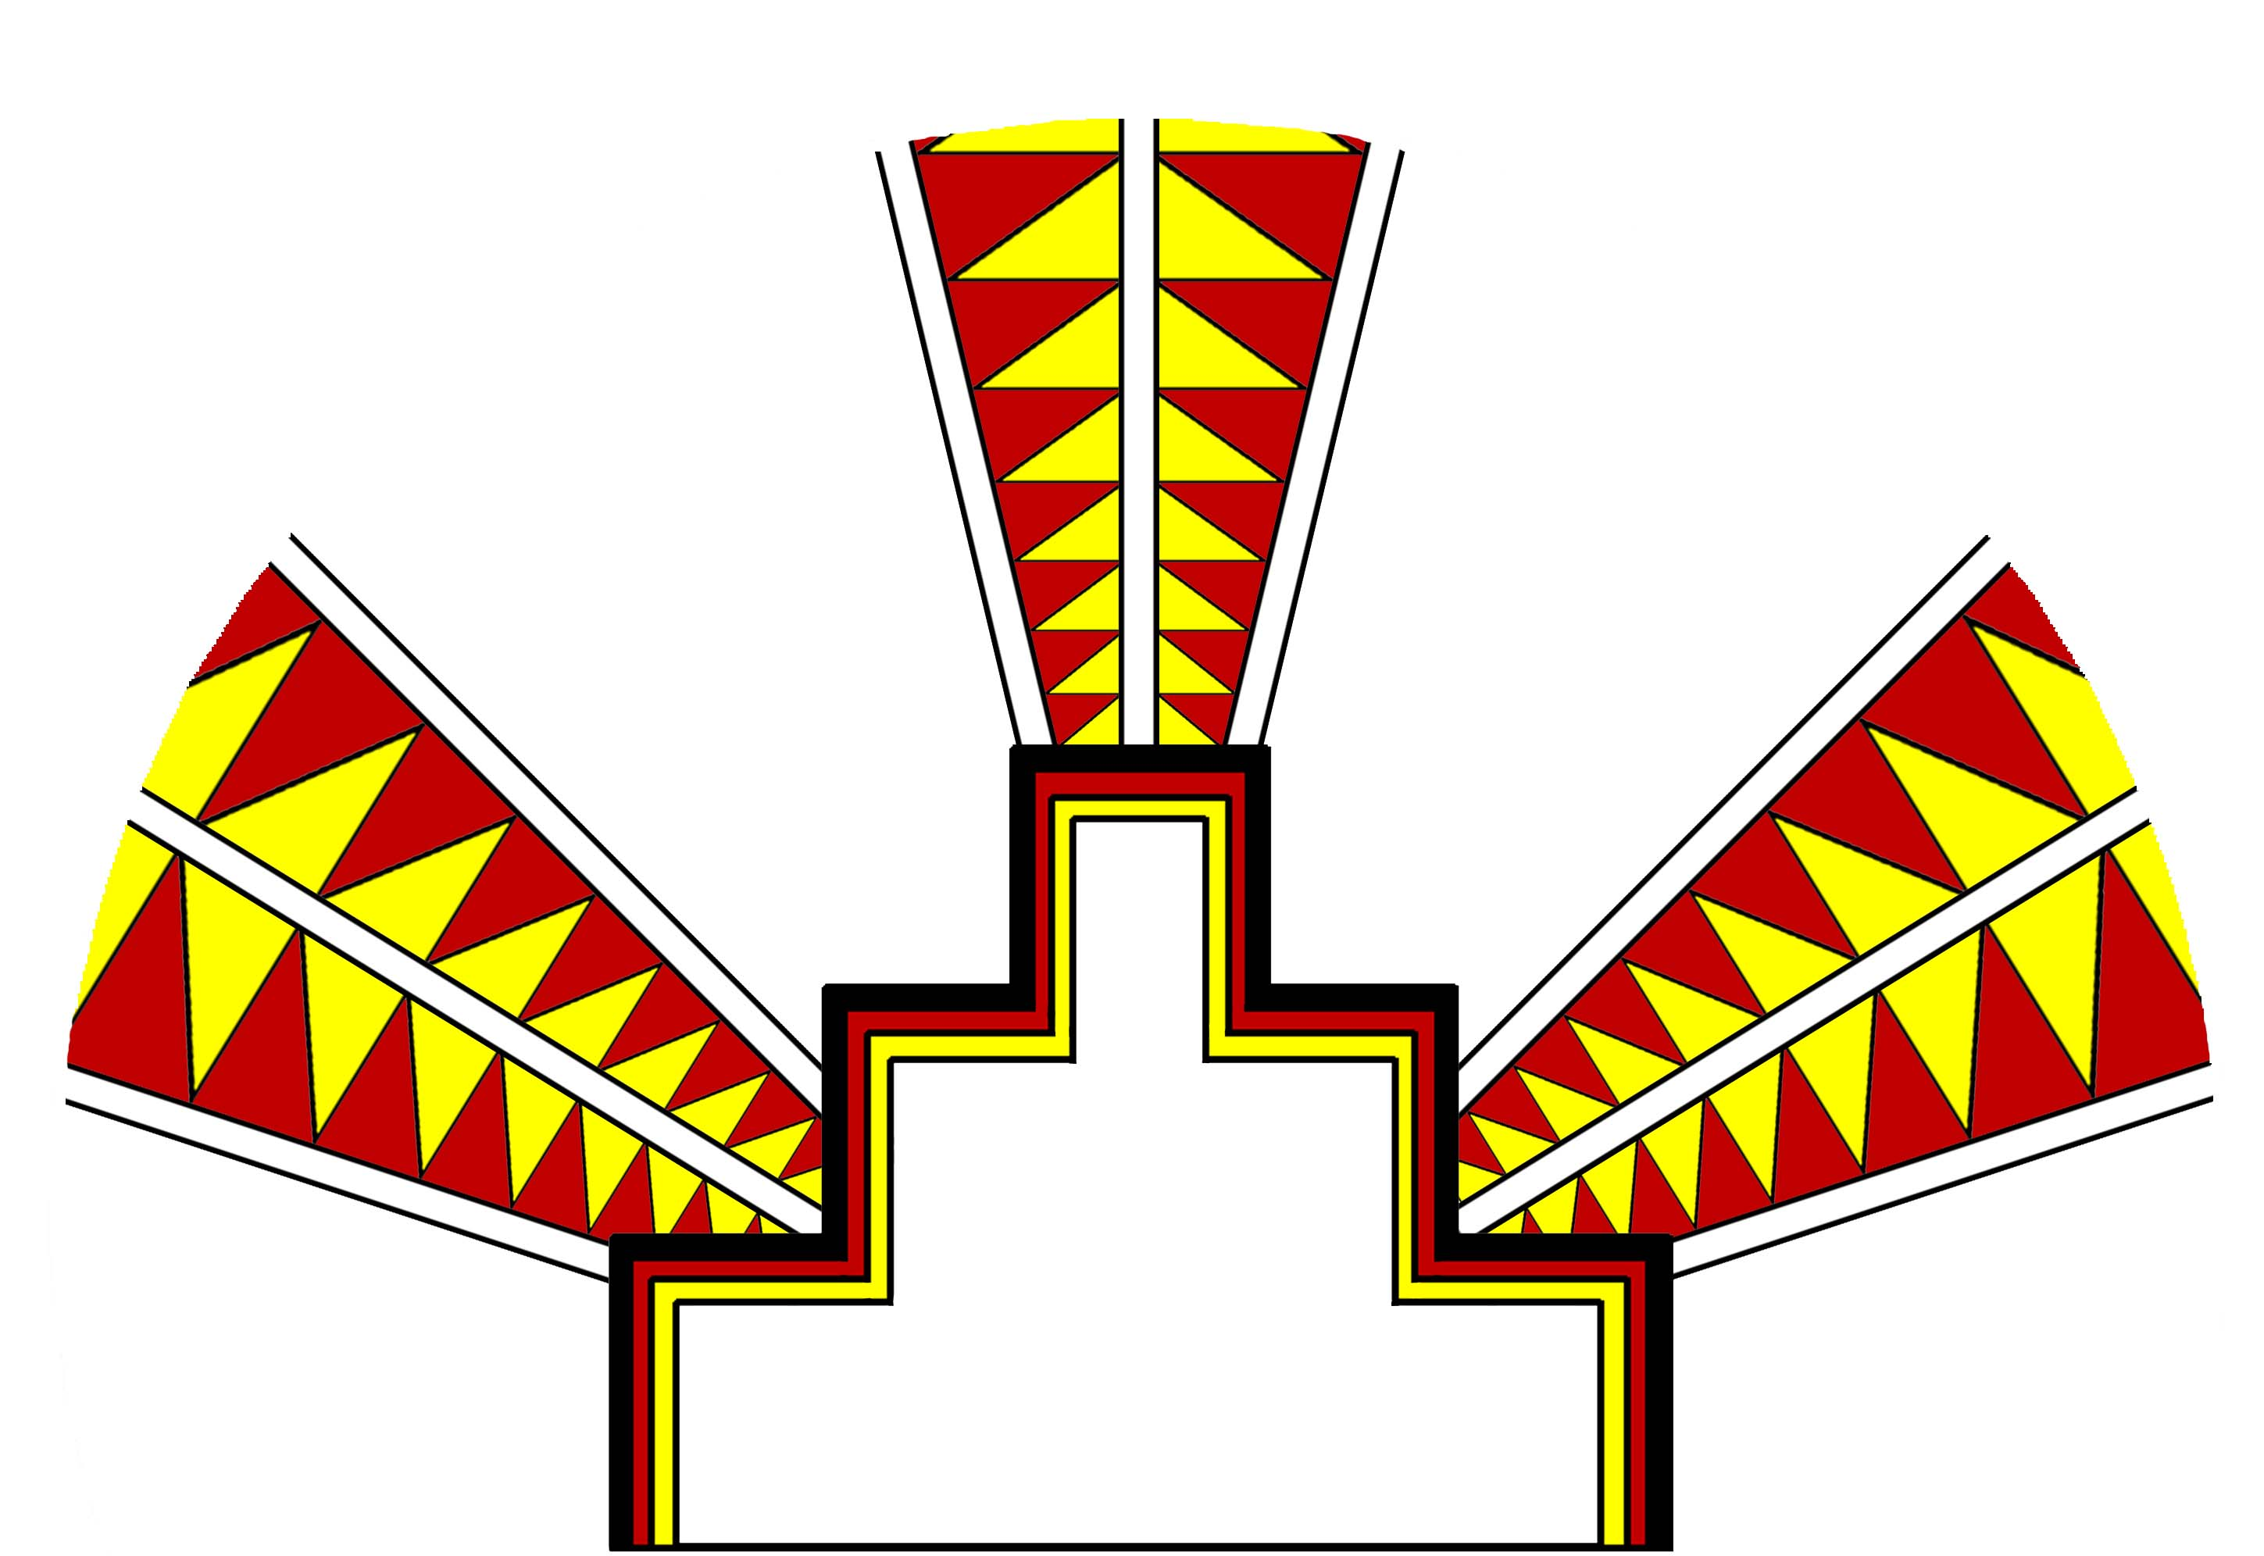
Project Stop the Use of Nicotine (SUN) Teen Cessation
2-year TRDRP grant
RCT
Native teen smokers ages 14-19 years (n=200)
Trained 30 Facilitators
CA Rural and Urban areas

Slide 19
Social Media Messaging
Pilot grant to train 10 Native American teens ages 16-24 years of age to create;
PSA – public service announcement
Digital Storytelling
Photovoice
Northern CA Tribes
Peer Educators
Middle/High School
Tribal Council

Slide 20
Youth Media Messages
American Indian Youth Video

Slide 21
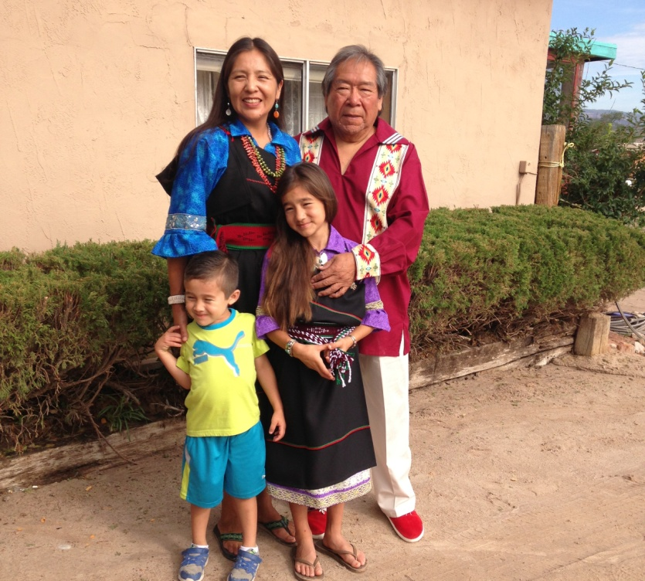
Thank you!!
Questions??
Claradina Soto, PhD, MPH
Associate Professor University of Southern California
Keck School of Medicine
Department of Population and Public Health Sciences Telephone: (323) 442-8219
toya@usc.edu

